Slide 1
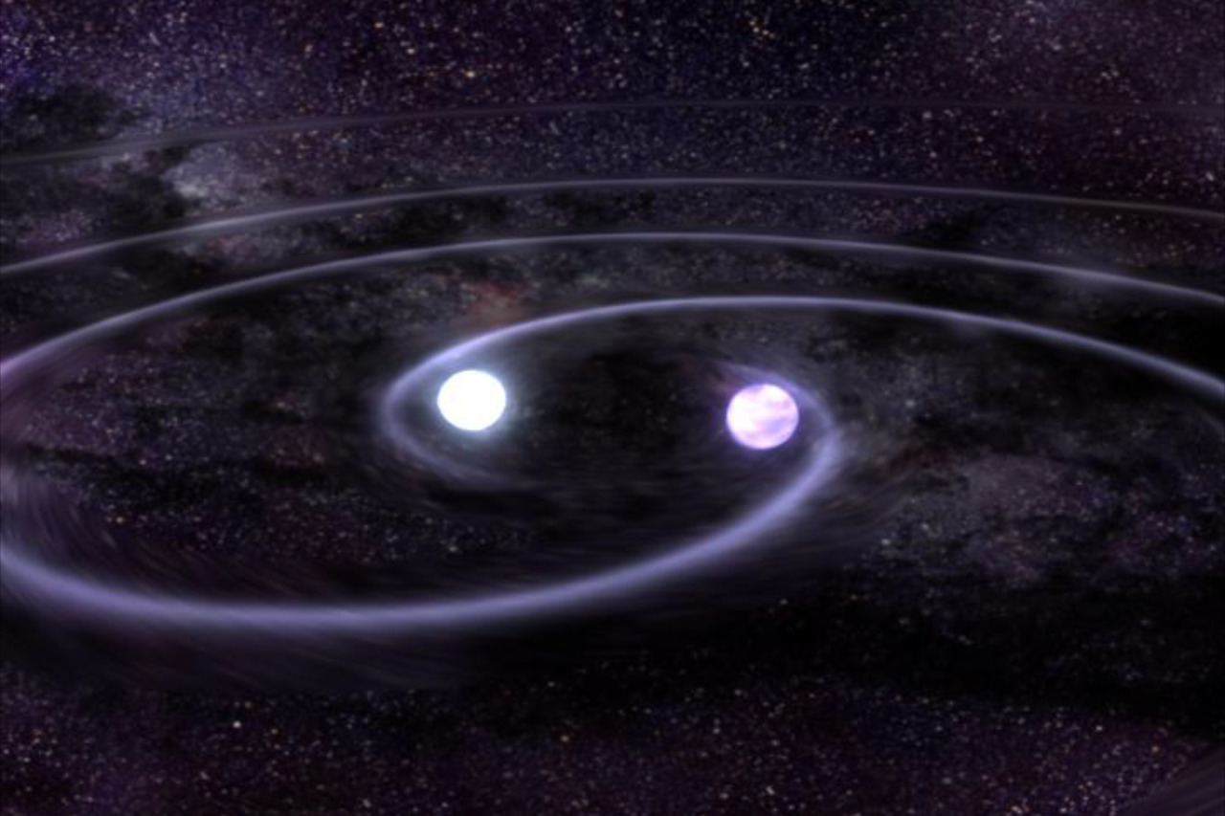
Detecting Exoplanets via Gravitational Waves
Marcus Haberland

Slide 2
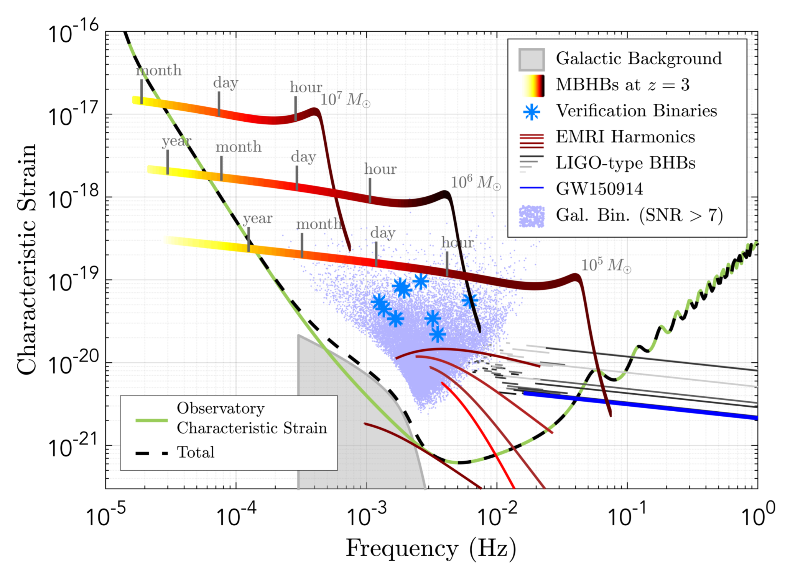
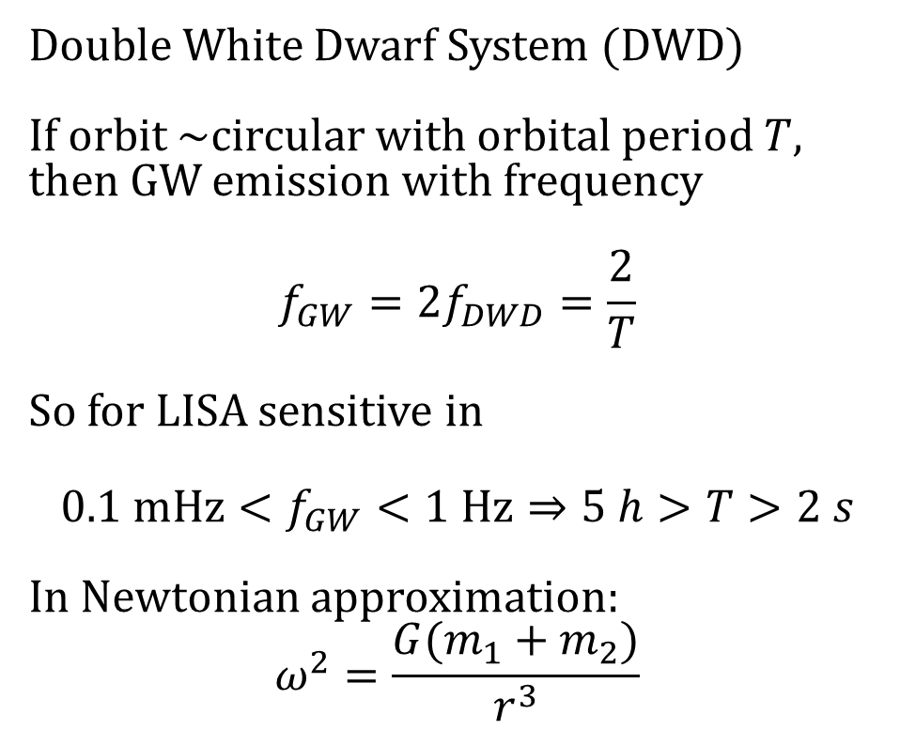
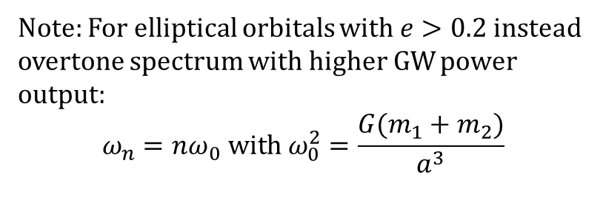
General Idea
Double White Dwarf System (DWD)
If orbit ~circular with orbital period $T$, then GW emission with frequency
$$f_{GW}=2f_{DWD}=\frac{2}{T}$$
So for LISA sensitive in
$$0.1 mHz<f_{GW}<1 Hz⇒5 h>T>2 s$$
In Newtonian approximation:
$$ω^{2}=\frac{G(m_{1}+m_{2})}{r^{3}}$$
Note: For elliptical orbitals with $e>0.2$ instead overtone spectrum with higher GW power output:
$$ω_{n}=nω_{0} with ω_{0}^{2}=\frac{G(m_{1}+m_{2})}{a^{3}}$$

Slide 3
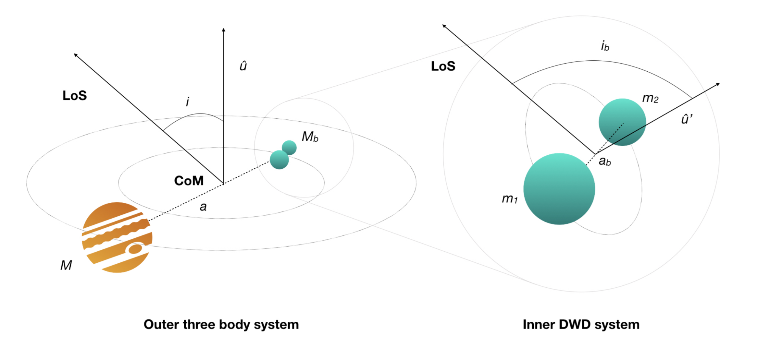
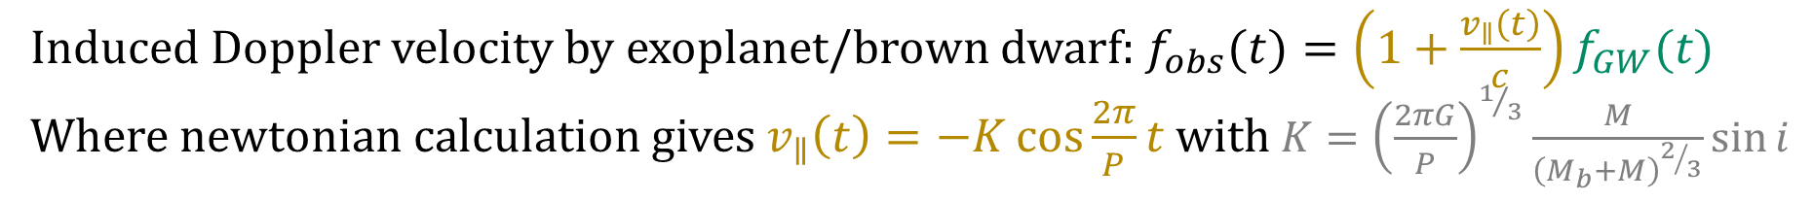
General Idea
Induced Doppler velocity by exoplanet/brown dwarf: $f_{obs}(t)=\left(1+\frac{v_{∥}\left(t\right)}{c}\right)f_{GW}(t)$
Where newtonian calculation gives $v_{∥}\left(t\right)=−K\cos{\frac{2π}{P}t}$ with $K={\left(\frac{2πG}{P}\right)}^{1/3}\frac{M}{{\left(M_{b}+M\right)}^{2/3}}\sin{i}$

Slide 4
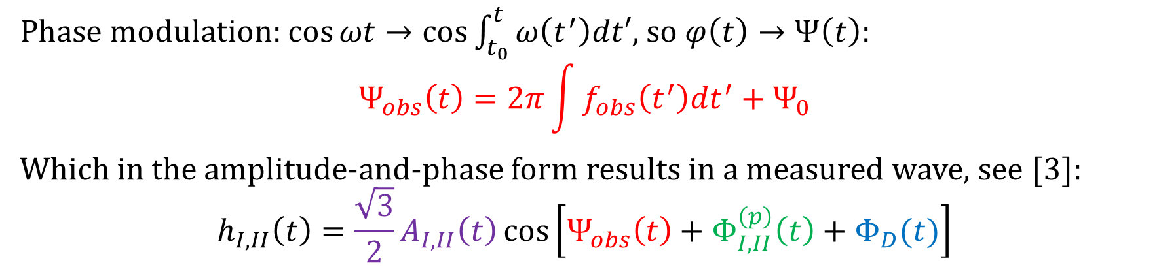
From emission to detection
Phase modulation: $\cos{ωt}→\cos{\int_{t_{0}}^{t}{ω\left(t^{′}\right)dt′}}$, so $φ\left(t\right)→Ψ\left(t\right):$
$$Ψ_{obs}\left(t\right)=2π\int{f_{obs}\left(t^{′}\right)dt^{′}}+Ψ_{0}$$
Which in the amplitude-and-phase form results in a measured wave, see [3]:
$$h_{I,II}\left(t\right)=\frac{\sqrt{3}}{2}A_{I,II}\left(t\right)\cos\left[Ψ_{obs}\left(t\right)+Φ_{I,II}^{\left(p\right)}\left(t\right)+Φ_{D}(t)\right]$$
Quantity we want to measure for information on planetary orbital period and mass (lower bound)
Doppler phase induced by rotation around the sun
Different polarization basis especially for LISA setup (equilateral triangle)
Polarization phase induced by rotation of detector wrt. Source (spin 2 graviton)

Slide 5
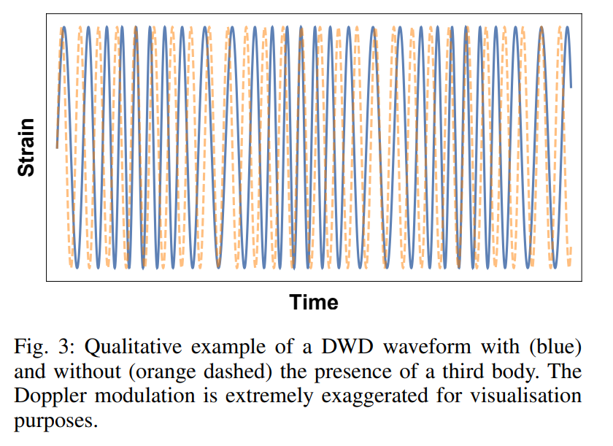
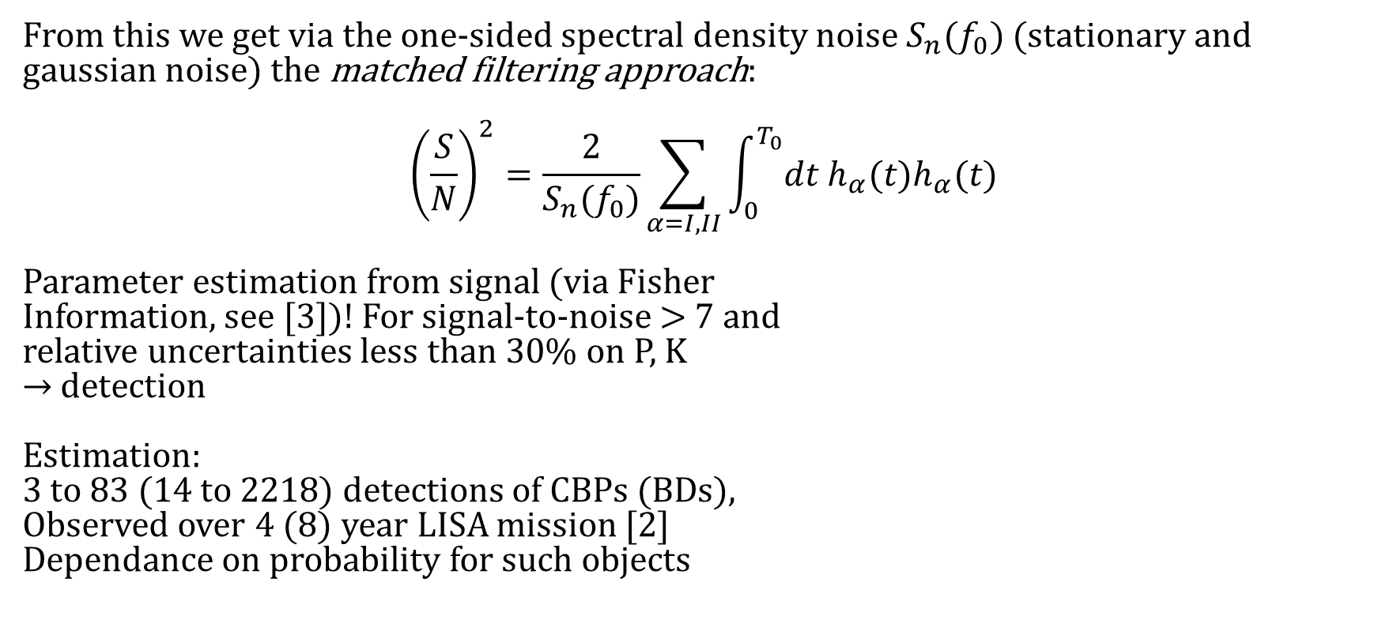
From emission to detection
From this we get via the one-sided spectral density noise $S_{n}(f_{0})$ (stationary and gaussian noise) the matched filtering approach:
$${\left(\frac{S}{N}\right)}^{2}=\frac{2}{S_{n}(f_{0})}\sum_{α=I,II}{\int_{0}^{T_{0}}{dt h_{α}(t)h_{α}(t)}}$$
Parameter estimation from signal (via Fisher
Information, see [3])! For signal-to-noise > 7 and
relative uncertainties less than 30% on P, K
$→$detection
Estimation:
3 to 83 (14 to 2218) detections of CBPs (BDs),
Observed over 4 (8) year LISA mission [2]
Dependance on probability for such objects

Slide 6
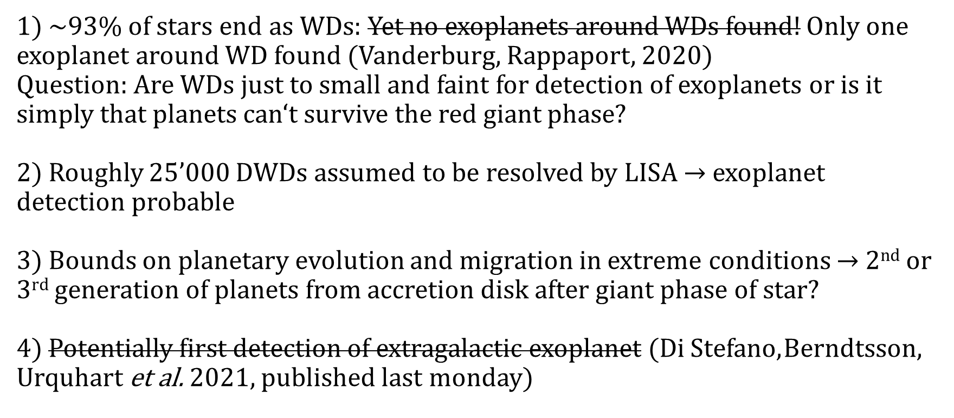
Why is this interesting?
1) ~93% of stars end as WDs: Yet no exoplanets around WDs found! Only one exoplanet around WD found (Vanderburg, Rappaport, 2020)
Question: Are WDs just to small and faint for detection of exoplanets or is it simply that planets can‘t survive the red giant phase?
2) Roughly 25’000 DWDs assumed to be resolved by LISA $→$ exoplanet detection probable
3) Bounds on planetary evolution and migration in extreme conditions $→$ 2nd or 3rd generation of planets from accretion disk after giant phase of star?
4) Potentially first detection of extragalactic exoplanet (Di Stefano, Berndtsson, Urquhart et al. 2021, published last monday)

Slide 7
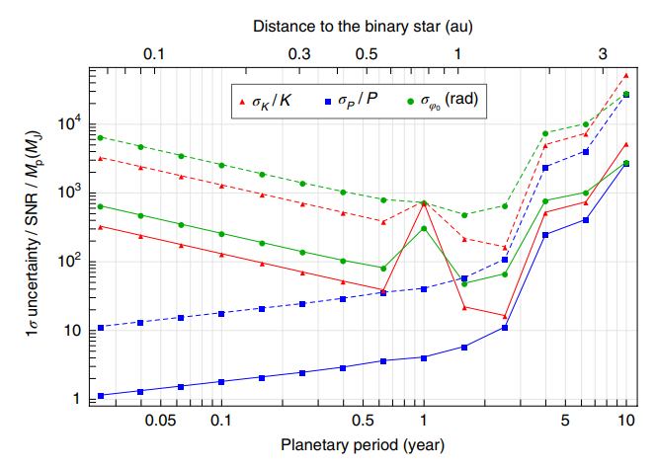

General assumptions for detection/parameter estimation
Resolution of individual DWD systems (from confusion noise) $→$ Need long mission lifetime $T_{0}$: Discrete Fourier Transform sorts monochromatic signals into frequency bins $Δf=1/{T_{0}}≪\frac{v_{∥}}{c}f_{GW}$
Less uncertainty for planet orbital period comparable to life-time $T_{0}$ and distinct from LISA‘s orbital period 1 yr
Newtonian validity: $v/c, {R_{S}}/d≪1$
Only one exoplanet dominating the radial motion

Slide 8
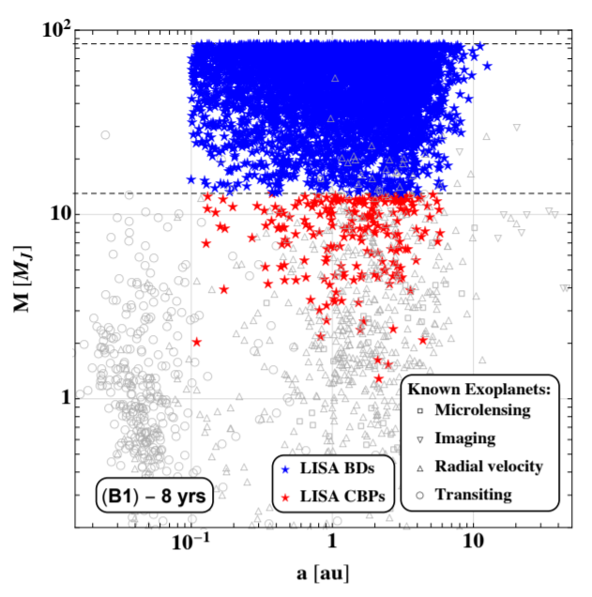

General assumptions for detection/parameter estimation
Bias towards: high $M$, $f_{GW}\sim 10 mHz$ and face on binaries (highest GW power output) in Local Group
Stability criterion for three-body system: $P≳4.5 P_{b}$
Far away from inspiral phase: $τ_{0}≈10 Gyr {\left(\frac{T_{0}}{1 hr}\right)}^{8/3}{\left(\frac{M_{⊙}}{M_{tot}}\right)}^{2/3}\left(\frac{M_{⊙}}{μ}\right)≫3300 yr$ [2] for detectable DWDs
Mock data [2] of detected exoplanets for optimistic case
Diagram from lecture 6

Slide 9
References
[1] Tamanini, N., Danielski, C. (2019). The gravitational-wave detection of exoplanets orbiting white dwarf binaries using LISA. Nat Astron 3, 858–866. https://doi.org/10.1038/s41550-019-0807-y
[2] Danielski, C., Korol, V., Tamanini, N., & Rossi, E.M. (2019). Circumbinary exoplanets and brown dwarfs with the Laser Interferometer Space Antenna. Astronomy and Astrophysics, 632.
[3] Cutler, C. (1998). Angular resolution of the LISA gravitational wave detector. Physical Review D, 57, 7089-7102.
[4] Maggiore, M. (2008). Gravitational Waves Volume 1: Theory and Experiments. Oxford University Press

Slide 10
Thank you for your attention!

